Slide 1


Dental Assisting II Program
Information Session
Dental Assisting II Diploma

Slide 2
What will be covered?
ACC Dental Vision and Mission
Program Options
Is Dental Assisting for me? Professional Expectations
Dental Assisting II Program Description
Dental Assistant vs Dental Hygienist
Limited Enrollment
Admission Requirements
Application Process
Next Steps

Slide 3


Dental Assisting II Program Mission
Mission Statement:
The Dental Assisting Department Mission is to provide dental assisting courses that prepare
graduates to assist the dentist in a variety of dental procedures, including; selective oral health
services, administrative management procedures, assess and manage emergency procedures, and develop basic communication skills necessary for effective interaction with patients, staff members, and professional colleagues by creating a learning environment where students can demonstrate professional and ethical behaviors necessary for functioning in a modern dental
practice and encourage further growth and lifelong learners.
- ACC Dental Department

Slide 4
Dental Assisting Goals
Provide the learning content and experiences and supportive environment that will enable students to
Gain the knowledge and ability to:
Student will develop the essential skills to assist the dentist in a variety of dental procedures
Students will perform expanded function procedures delegated to a Dental Assistant II in the state of North Carolina.
Students will demonstrate the ability to complete laboratory procedures delegated to a Dental Assistant II in the state of North Carolina.
Students will provide basic oral health instructions while utilizing diagnostic aids bases on the patients’ individual needs.
Students will demonstrate and apply knowledge of basic oral facial anatomy.
Students will demonstrate knowledge of basic radiation safety related to personal and patient protection.
Students will expose, process, and evaluate radiographic for a prescribed procedures meeting all Federal and State criteria.
Students will demonstrate the ability to assess and initiate emergency care.
Students will demonstrate the ability to perform basic operations of the business office in a dental practice
Students will demonstrate OSHA and CDC compliant infection control methods to properly maintain the asepsis chain.
Students will demonstrate ethical and professional behavior throughout the program maintaining HIPAA
(Health Insurance Portability and Accountability Act) compliance.

Slide 5
Dental Assisting Goals
Maintain program accreditation by the Commission on Dental Accreditation of the American Dental Association for quality assurance.
Encourage life-ling learning and professional development through certification by Dental Assisting National Board.
Maintain partnerships with the local dental community fostered by giving and
receiving assistance in job placement, continuing education, community service,
consultation, and by providing qualified Dental Assistant II’s.

Slide 6


Program Options at ACC
Dental Assisting II Diploma
ACC Day option begins every Fall semester – 3 semesters
Classes 8:00am – 3:30pm,
Monday – Thursday; Friday 8:30am – 1:30pm
28 Students submitted each fall
ACC Evening option begins every Fall semester – 5 semesters
Class begins at 5:30pm - 2 nights weekly
*Class time frame varies 2 to 4 hours (contingent on the lab length)
12 Students admitted each fall

Slide 7

UNC ACC Day option begins every Spring - 3 semesters
Classes 8:30am – 2:30pm, Tuesdays and Thursdays,
Monday Wednesday and Friday – Online class live, 8:00am – 12:00pm
20 Students admitted each Spring
*Students admitted to the UNC option are subject to the same admissions and progression criteria as all dental assisting cohort students. This one-year diploma program will begin in January and finish in December.
Courses for this cohort will be taught on the UNC Adams School of Dentistry campus.

Slide 8
Is Dental Assisting for me?
Self Reflection
Evaluate your academic and communication skills
What is your “why”?
Job shadow a Dental Assistant
Ask questions
Time Commitment is 1.5 to 2 years

Slide 9
The Profession
The Profession The Dental Assisting profession is a vital component in the dental healthcare delivery team. The US Department of Labor’s Occupational Outlook Handbook lists Dental Assisting profession to grow at an increase of 19% between the years 2016-2026. This is stated this growth is faster than the average for all occupations.
(2019, www.bls.gov)

Slide 10
The Dental Assistant
Dental assistants greatly increase the efficiency of the dentist in the delivery of quality oral health care and are valuable members of the dental care team. If you have strong communication skills, enjoy working with your hands as well as your mind and want a career with responsibility, dental assisting is for you.

Slide 11
Dental Assisting II Program Description
The Dental Assisting Curriculum prepares individuals to assist the dentist in delivering dental treatment and to function as integral members of the dental team while performing chairside and related office and laboratory procedures.
Course work includes instruction in:
general studies
biomedical sciences
dental sciences
clinical sciences
clinical practice.
A combination of lecture, laboratory, and clinical experiences provide students with detailed knowledge in infection/hazard control, radiography, dental materials, preventive dentistry, and clinical procedures.

Slide 12
Dental Assisting II Program Description
Some of the many expanded functions a DA II can legally perform are:
apply sealants
insert matrix bands and wedges
place cavity bases and liners
place and/or remove rubber dams
place and remove temporary restorations
take wax bites
remove sutures
expose radiographs
perform coronal polish
Upon graduation, graduates will be classified as a Dental Assistant II (DAII), as defined by Dental Laws of North Carolina
Graduates may be eligible to take the Dental Assisting National Board exam to be come a Certified Dental Assistant, CDA

Slide 13
Dental Assistant Vs Dental Hygienist
Dental Assistants perform a wide range of dental and administrative patient care duties.
Assists with a variety of dental functions
Perform NC expanded functions
Preparing & sterilizing dental instruments
Processing x-rays and laboratory tasks
Educating patients on healthy oral hygiene practices
Scheduling follow-up appointments
Processing billing and payment requests
Dental Hygienists responsibilities include cleaning teeth, examining patients for oral disease, and educating patients on preventive dental care practices.
Taking x-rays of patients mouths to check for problems with teeth or jaw alignment
Removing tartar, stains and plaque from patients’ teeth and applying fluoride treatment.
Completing oral health assessments
Taking notes regarding patient care and treatment plans
Educating patients on brushing and flossing properly for optimum dental health

Slide 14
Limited Enrollment
Although we would love to accept everyone into our Dental Assisting II programs, space is limited. Dental Assisting is limited enrollment, which means students must apply for the program. There are specific admission criteria, a separate admission application, and ranking processes that determine who will be admitted to the program.
– Joanna Roberts, Dental Assisting II Department Head

Slide 15
Points for Dental Assisting Ranking General Education Requirements
ENG 111 – Writing and Inquiry
PSY 150 – General Psychology
BIO 163 – Basic Anatomy & Physiology OR
BIO 168 & 169 – Anatomy & Physiology I and II
Grades of A’s and B’s receive the most points.
A minimum grade of “C” is required for all general education courses.

Slide 16

Professional Technical
Standards
Essential Functions & Technical Standards reflect reasonable expectations of a student on the Dental Assisting Program for the performance of common dental assisting functions. In adopting these standards the DA program is mindful of the patient’s right to safe and quality dental care by students.
Critical Thinking/Problem Solving
Interpersonal Skills
Coping Skills
Communication Skills
Mobility/Motor Skills
Hearing Skills
Visual Skills
Tactile Skills
Behavioral/Emotional

Slide 17
IMPORTANT NOTE TO APPLICANTS: Infection control guidelines for the Dental Assisting program have been developed to protect the student and the patient from disease transmission and are articulated in specific program courses. Students will have the knowledge and skill to deliver patient care safely through classroom instruction and laboratory experiences. A student in the dental assisting program is at an increased risk for exposure to a variety of diseases including Hepatitis C, HIV/AIDS, and tuberculosis. Because of these risks, students are expected to follow all infection/hazard control guidelines that have been established within the program and other infection control agencies.

Slide 18
ADMIISSION REQUIREMENTS
Part 1
Submit ACC application for admission - www.alamancecc.edu) (Early application is important for Limited Enrollment programs as seats are limited)
Complete NC Residency Verification
Submit high school and post secondary transcripts
Apply for Financial Aid - www.fafsa.gov
Activate your ACCess student email account
Attend or complete required Pre-Dental Information Session
Make an appointment with your Health Sciences Advisor team
Note: It is YOUR responsibility to ensure that ACC’s Admissions
Office has received all of the above required documents

Slide 19
ADMISSION REQUIREMENTS
PART 2
Submitted transcripts will be reviewed and evaluated for transfer consideration.
College courses must be a C or better for transfer
AP credit can be also be evaluated for ENG 111 and PSY 150
(Must submit scores from College Board)

Slide 20

Application Submission
Attended or completed Pre-Dental Information Session
Maintained a 2.0 GPA or better
Passed all General Education required courses with a grade of C or better
Completed online Dental Assisting II Information Session & Survey
Next step: Complete and submit Dental Assisting II Application

Slide 21
Dental Assisting II Application Due Dates
April 4th – Alamance Community College Day and Evening programs, Fall start
October 20th – University of North Carolina-Alamance Community College Day program, Spring start

Slide 22
Contact Information
More Dental Assisting Information
https://www.alamancecc.edu/health-and-public-services-
site/dental-assisting/
Health Sciences Advisor
Susan Turner
336-506-4266
sjturner588@alamancecc.edu
Dental Department Head
Joanna Roberts
joanna.roberts@alamancecc.edu
336-506-4153

Slide 23

Dental Information Survey https://forms.gle/txxLwwSqjqmmb7U67

Slide 24
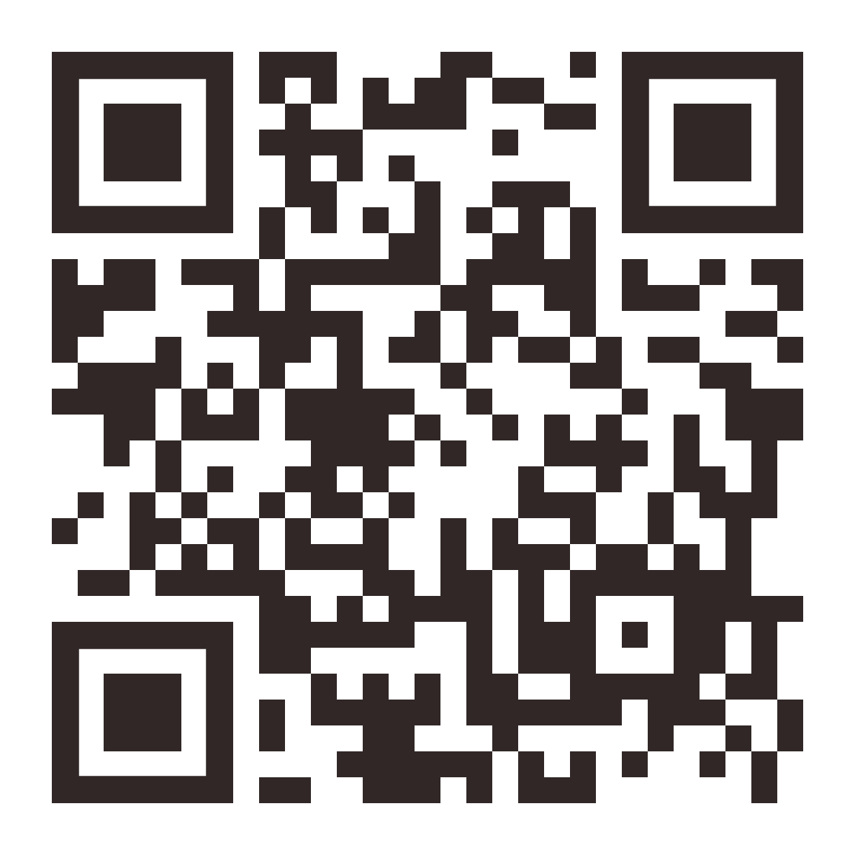
Dental Info Checklist Survey -https://forms.gle/VPpEToqKwGruYJAAA

